Slide 1
Splitting Orders already in transit
Breakdowns are unavoidable. In those situations we may need to
repower the order and will still need to maintain the same invoice.

Slide 2
Begin by accessing the Travel Order

Slide 3
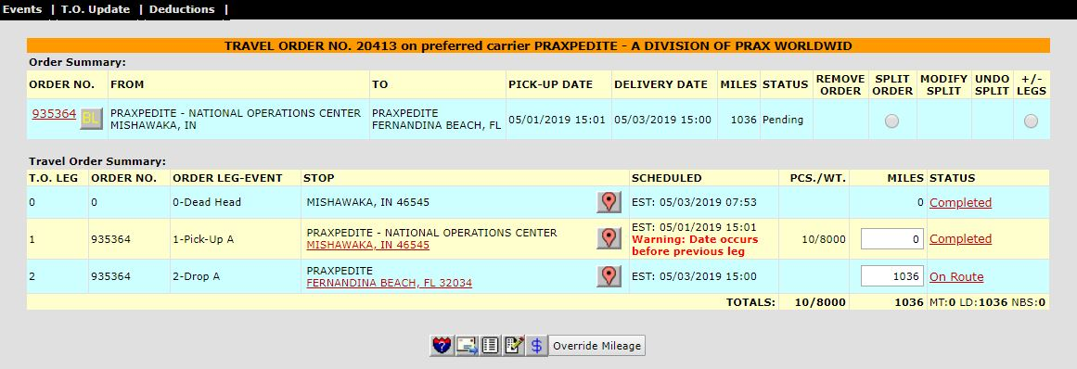
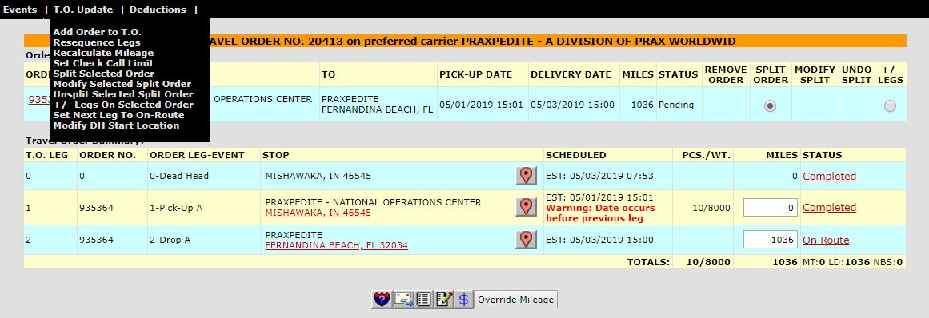
Click “Split Selected Order” from the T.O. Update Menu
Click the Split Order button to begin

Slide 4
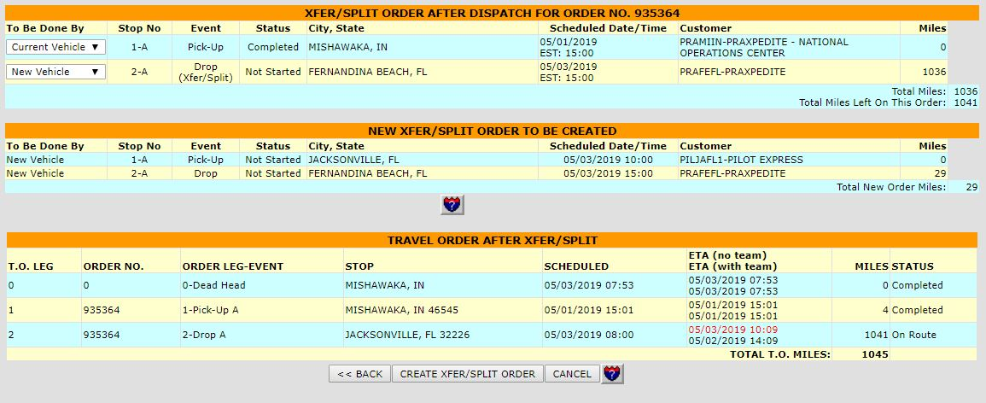
You will need to know where the broken down truck is located and build that customer code. We have already built the Pilot Express where this truck is broken down.
Enter the Customer Code or Search for the Customer
Enter the time the truck broke down
Enter the ETA for the recovery truck (or set this out ~1 hour if you plan to post it)
Press Continue
Click “CREATE XFER/SPLIT ORDER”

Slide 5
The order has now been split.
This screen serves as confirmation

Slide 6
When you return to the Manage Orders / Order Inquiry screen and press “Search” with the original PRO it will return both PROs
You can now post to find coverage or assign a truck to the new order

Slide 7
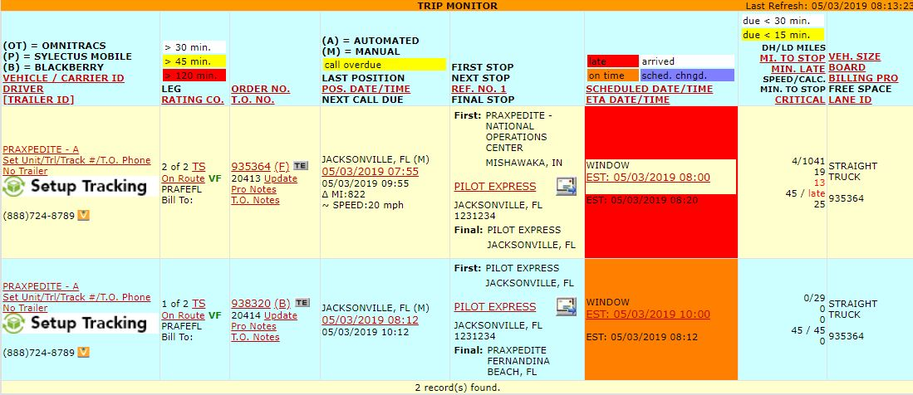
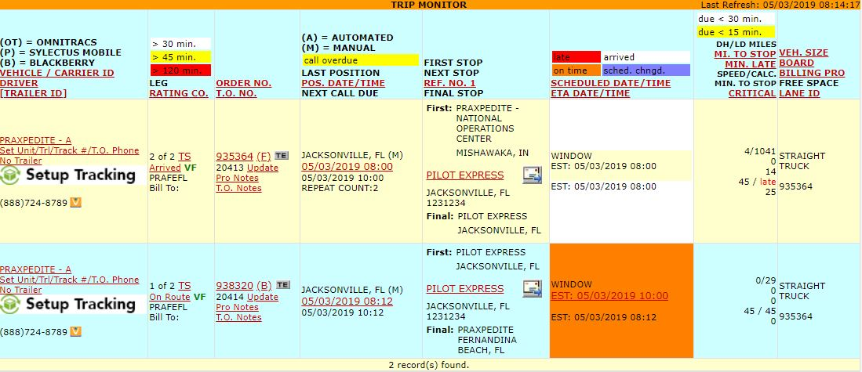
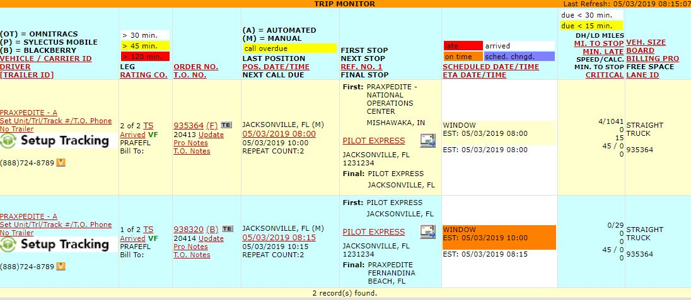
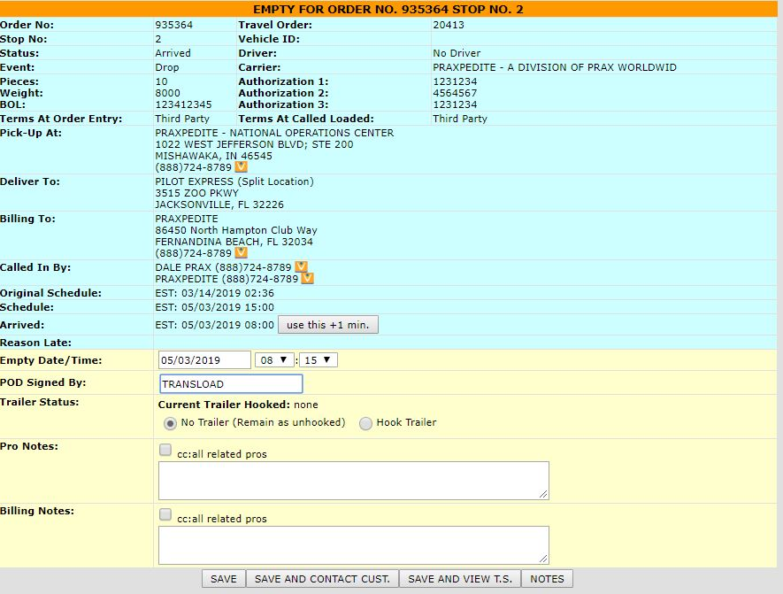
Arrive the broken down truck at the Pilot Station (Receiver)
Once the recovery truck arrives, arrive it at the Pilot Station (Shipper)
Once the transload is complete, we need to close out the broken down truck
Enter “TRANSLOAD”in the “POD Signed By” Field
On the trip monitor, the receiver for the broken down truck now reflects the Pilot Station.
Click “Save”

Slide 8
Load the recovery truck

Slide 9
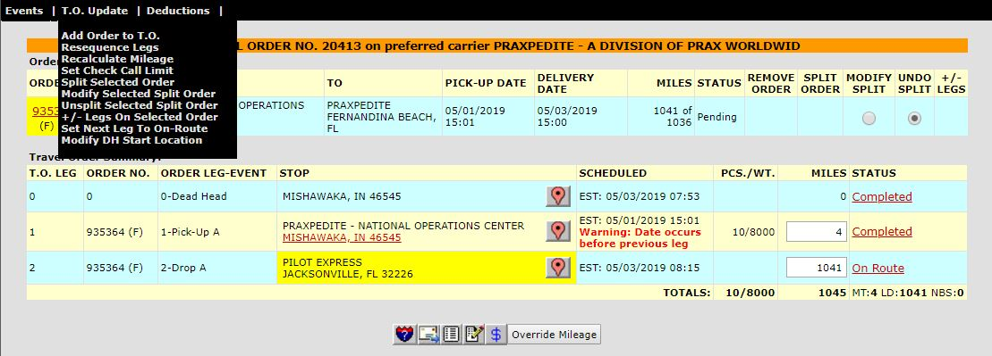
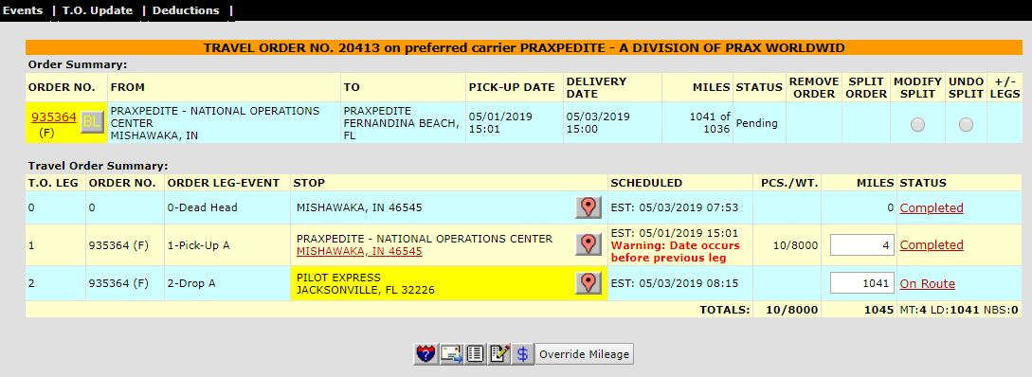
Click “Unsplit Selected Split Order” from the T.O. Update menu
Click the “UNDO SPLIT” Radio Button
If you need to undo the split, return to the Travel Order
Please note that you can’t undo a split if a truck is assigned to the on the recovery truck. You will have to cancel that Travel Order first

